Slide 1
Step 1 :Geometric Margin Filtering – Analysis and Decision
Aim :
To neutralize edge effects and isolate the true crop-growing area within the field – based on the understanding that field edges may contain non-representative data (e.g., margins, bare soil, measurement errors).

Slide 2
Process Performed: A comparison was made between NDVI and GRVI values inside the plot versus the outside, using 30-meter buffer rings. All the different plots were analyzed (e.g., Yifat V, Dan Beit Hillel, Yagur 72, etc.). Graphs showed high standard deviations in the edge areas, which distort the true picture of vegetation condition.
Conclusions: A fixed 30-meter cut from each side was determined – this fits the satellite resolution (30×30 meters) and prevents distortions in the analysis layer. A larger cut results in loss of essential information, and a smaller cut is insignificant at this resolution. GRVI was not found useful in edge analysis and therefore was not used in the decision-making process regarding cut depth.
Result: Only internal, consistent, and reliable geometric areas were preserved – for further statistical analyses, normalization, and model building.

Slide 3
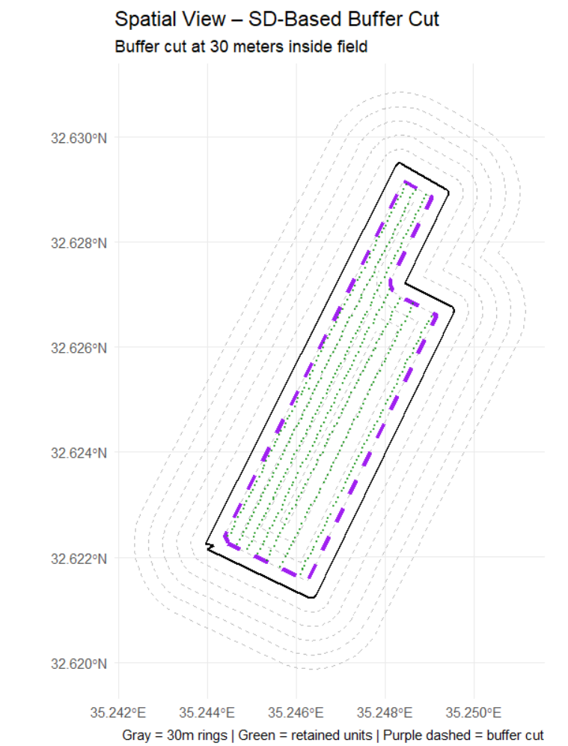
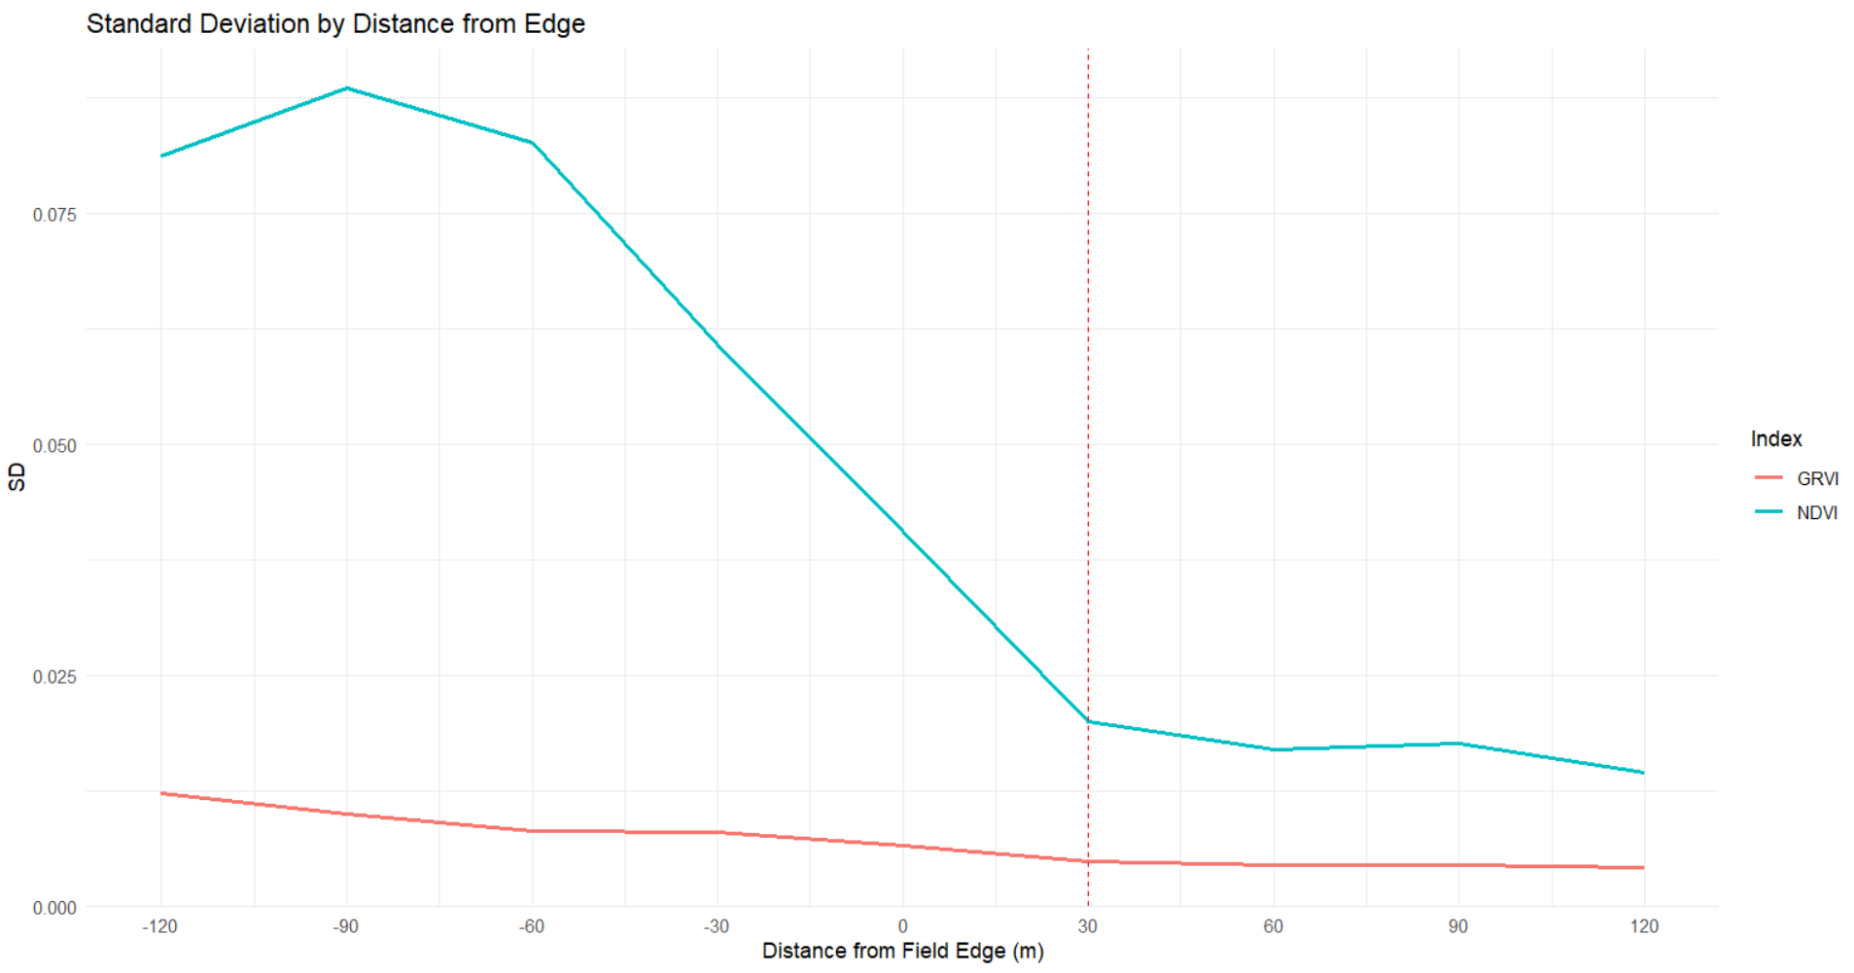
An example from the analysis:
Yifat V.

Slide 4
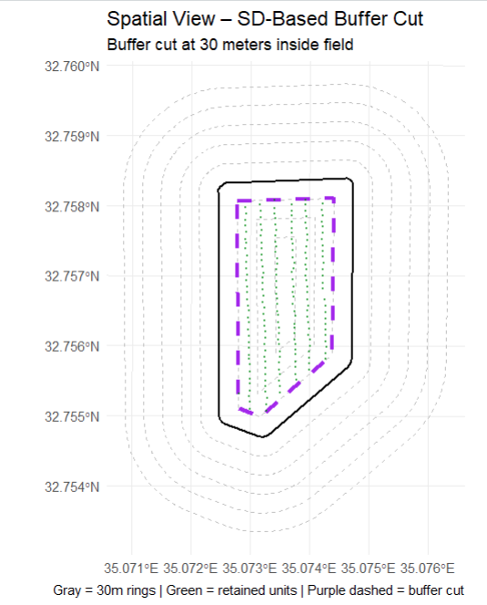
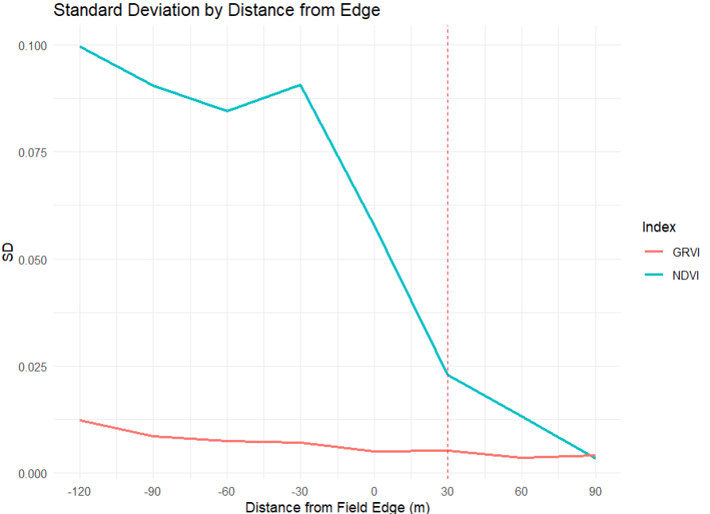
Yagur 72

Slide 5
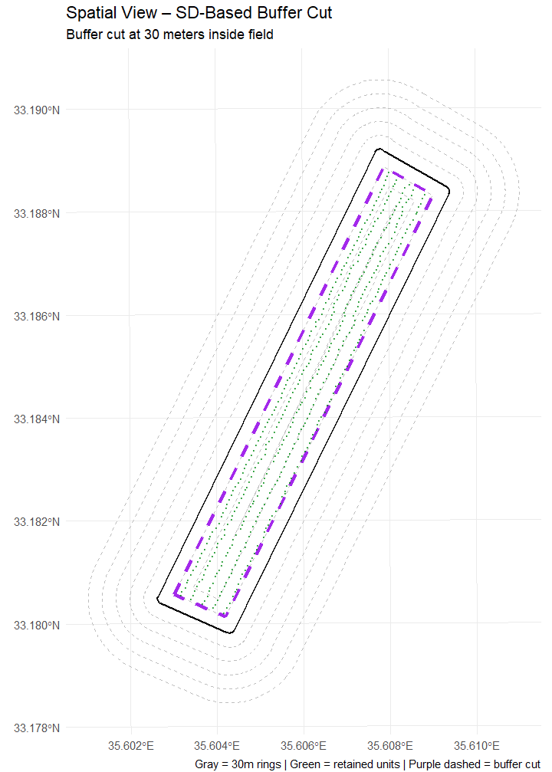
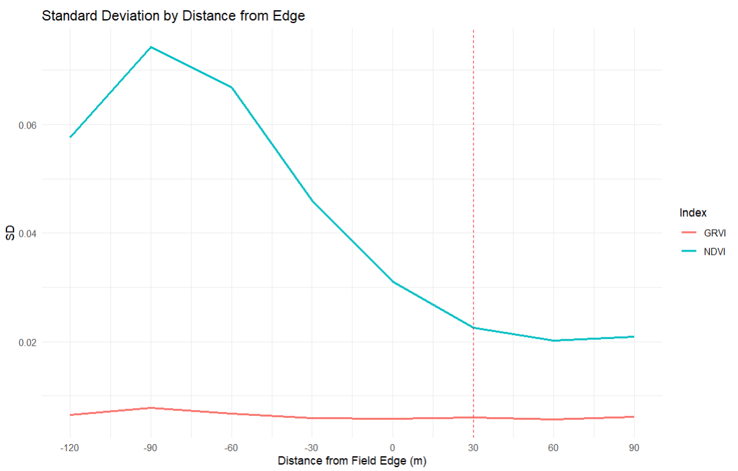
Dan Beit Hillel

Slide 6
Step 2: Normalization – NDVI Creating a Comparative Index Between Plots
Objective:
To create a normalized NDVI index on a scale from 0 to 1 for each pixel – in a way that neutralizes seasonal, topographic, and geographic effects, and enables comparison between pixels within and across fields.

Slide 7
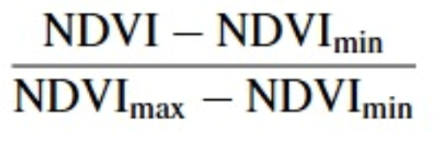
The normalization method performed:
Instead of using the raw minimum and maximum NDVI values from the entire field, we used ground-truth samples with broomrape at extreme infestation levels to define the scale range:
NDVI min was calculated as the average NDVI of the 10 lowest pixels in infestation level 3 (or level 2 if necessary).
NDVI max was calculated as the average NDVI of the 10 highest pixels in infestation level 0 (or level 1 if necessary).

Slide 8
Normalization over the years
What did we do after determining NDVI_min and NDVI_max in the reference years:
After finding the NDVI_min and NDVI_max values based on real samples, we checked in which quantiles of the NDVI value distribution within each plot they fall, and marked them as reference points.
Continued normalization over the years:
Since we don't have real samples in the following years- for each additional year we used the same quantiles (e.g., 5% and 95%) as anchors to define the normalization range:
NDVI_min for each year → the value at the quantile chosen for the minimum in the original year
NDVI_max for each year → the value at the quantile chosen for the maximum in the original year
In this way, we created a uniform and consistent normalization range for each plot – throughout the years.

Slide 9
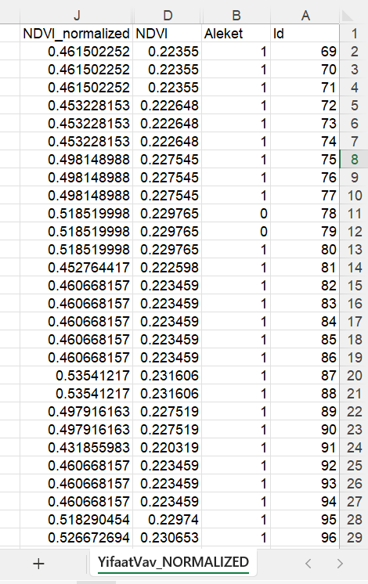
Result:
For each plot, a normalized NDVI file was created for the reference year according to this formula.
GRVI was permanently excluded from the analyses.
These layers were later used to build a logistic regression model and for risk forecasting.

Slide 10
Step 3: Preliminary Statistical Analysis – Relationship Between NDVI and Broomrape Levels
Objective: To examine whether there is a significant correlation between the normalized NDVI values and broomrape infestation levels (Aleket 0–3), in order to filter relevant plots for further development of a probabilistic model.

Slide 11
Repetition of Tests Performed in Semester A:
Kruskal-Wallis Test – Examines whether there are statistically significant differences in NDVI values between the different Aleket (broomrape infestation) groups.
Spearman Rank Correlation Test – Checks for a monotonic trend – whether NDVI decreases as the broomrape level increases.
Process:
All normalized field data were combined into a single file.
Summary statistics were calculated for each field: NDVI mean, standard deviation, and percentages for each Aleket level.
Statistical tests were conducted for each field individually.

Slide 12
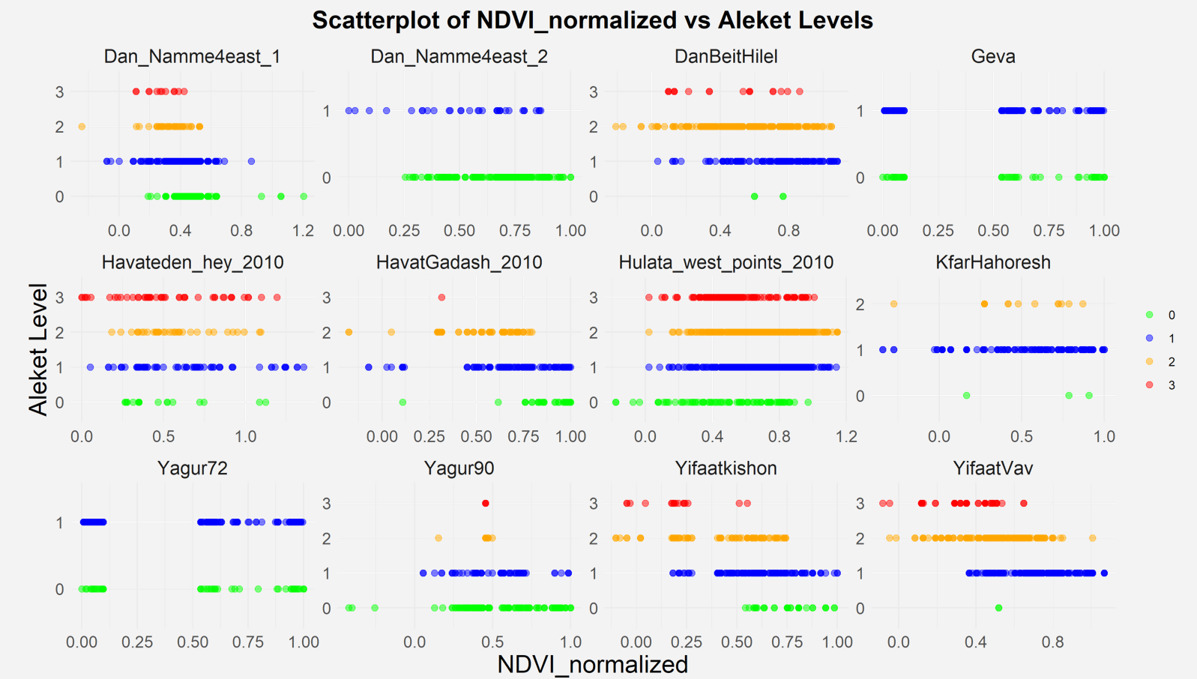
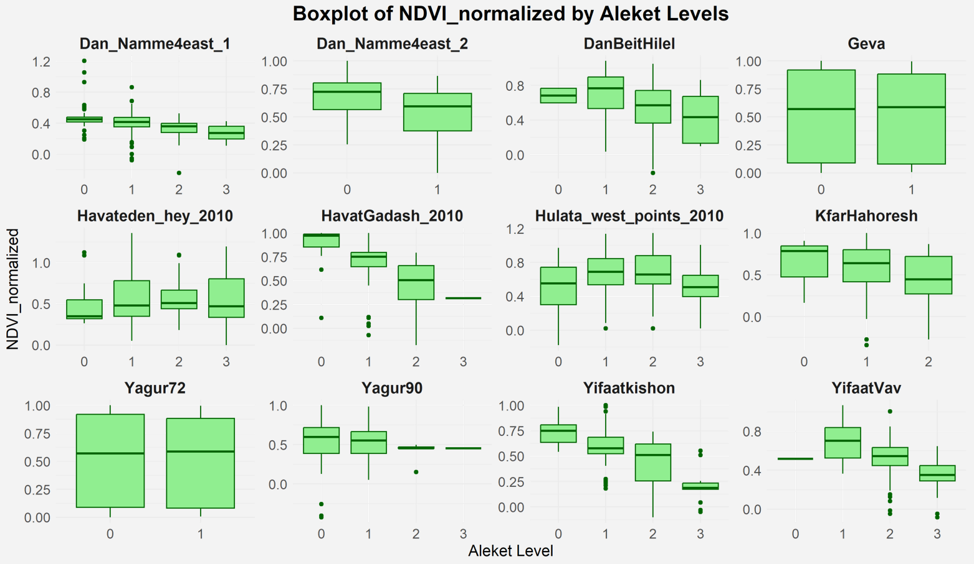
2010 plots

Slide 13
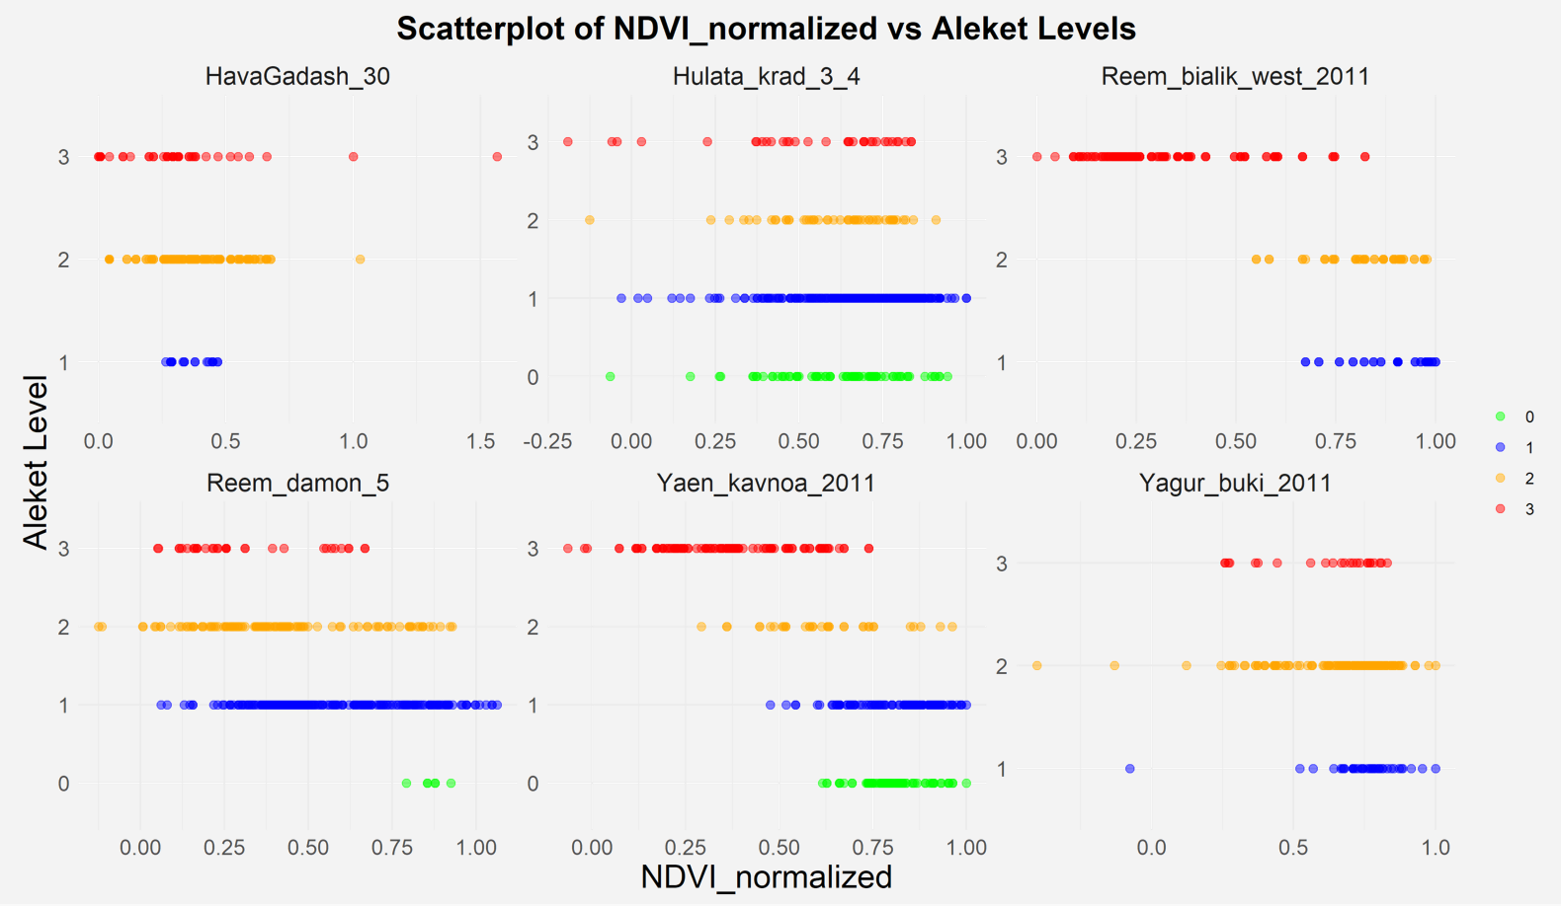
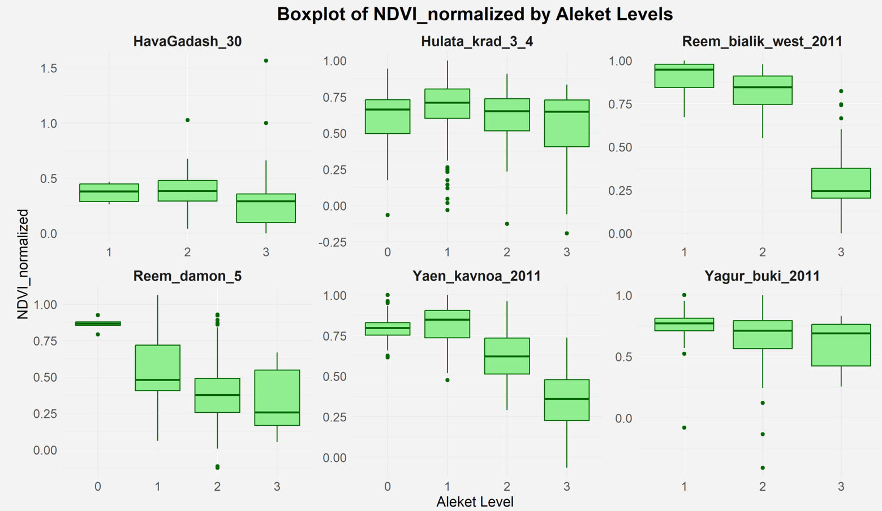
Plots 2011

Slide 14
Summary of the results:
A significant relationship was found in 4 plots:
Gedesh Farm
Yifat V
Re’em Bialik West
Ya’an Konoa
In each of these:
Statistically significant differences were found in NDVI values between broomrape infestation levels (p < 0.05).
A negative monotonic relationship was found – the lower the NDVI, the higher the broomrape level (ρ was negative and significant).

Slide 15
Step 4: Neutralizing Geometric Variability Across Years
Objective:
To isolate for analysis only the geometrically consistent area within each plot – meaning an area that maintained the same location, coverage, and crop throughout all years (from the reference year until 2024).

Slide 16
Process Performed:
Viewing the RGB layers of each plot over the years (2011–2024).
Identifying changes in planting direction, unplanted areas, or changes in field size or location.
Creating an overlap between the reference year polygon and the polygons of all other years.
Keeping only the shared cut area – i.e., the area that was actively used for agriculture in all examined years.
Result: For each of the 4 selected plots, a polygon was created for the years 2010–2024 – to be used in longitudinal analyses and in applying the probabilistic model.

Slide 17
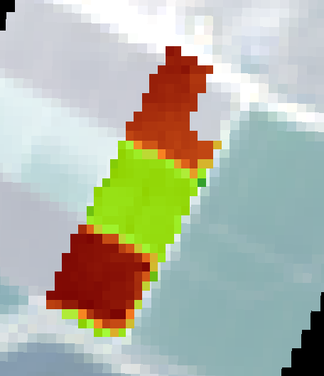
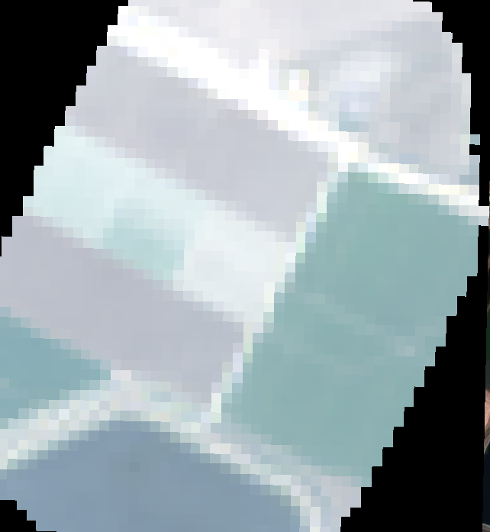
Plot Yifaat 6 2014

Slide 18

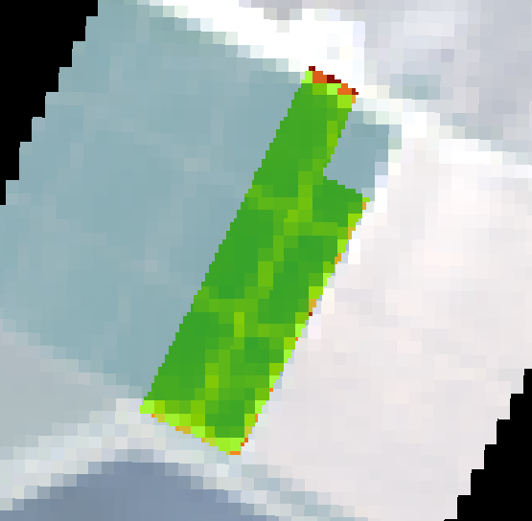
Plot Yifaat 6 2015

Slide 19

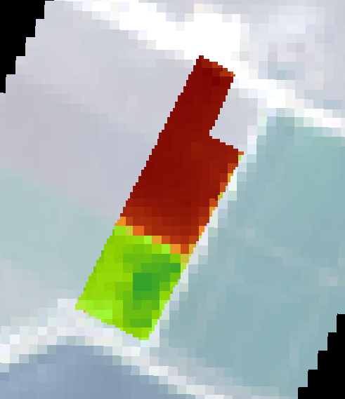
Plot Yifaat 6 2016

Slide 20
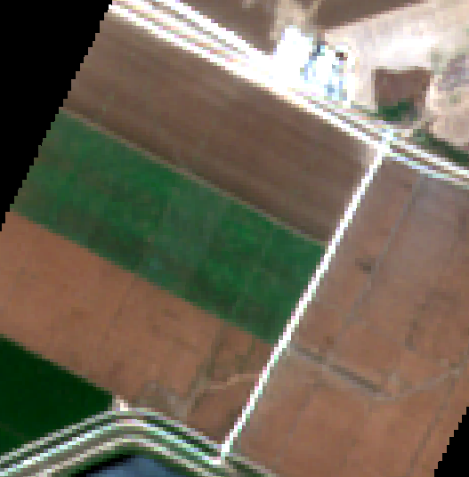
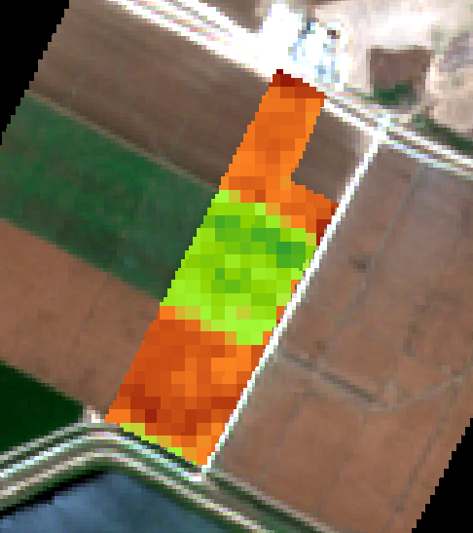
Plot Yifaat 6 2017

Slide 21
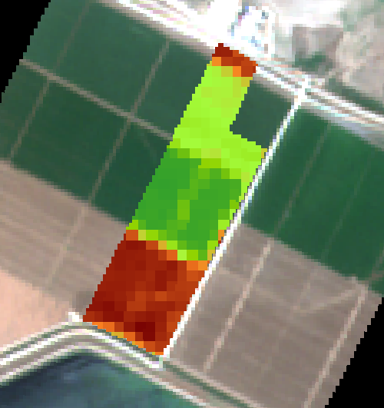
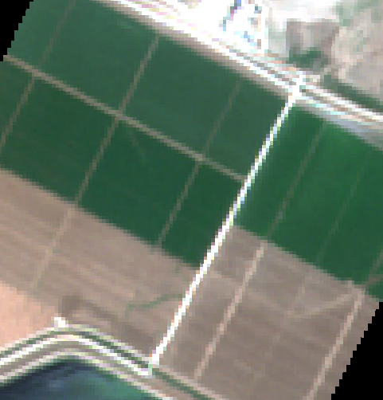
Plot Yifaat 6 2018

Slide 22
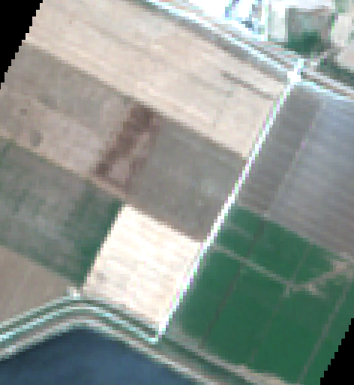
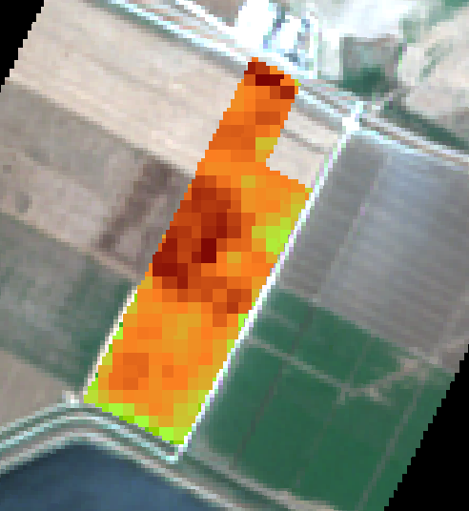
Plot Yifaat 6 2019

Slide 23
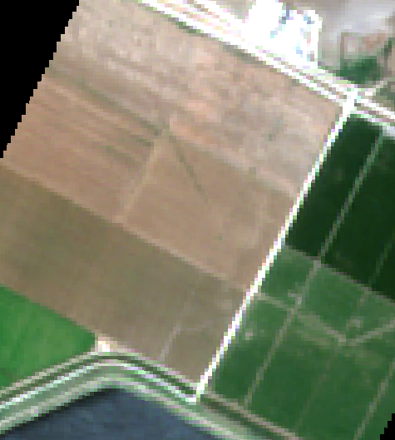
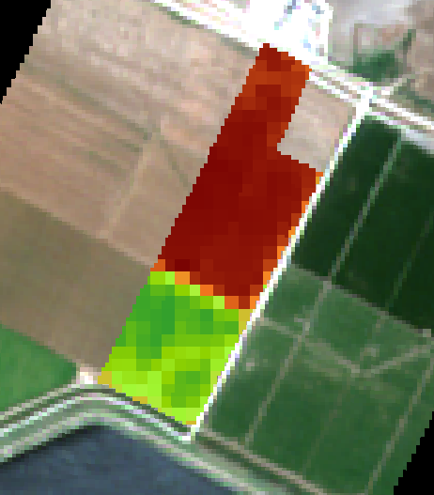
Plot Yifaat 6 2020

Slide 24
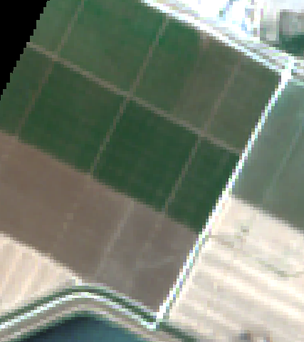
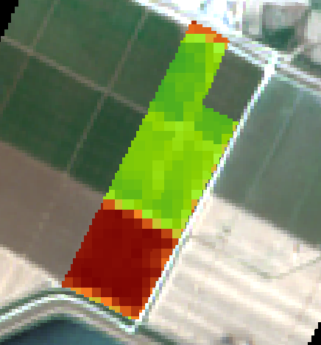
Plot Yifaat 6 2021

Slide 25
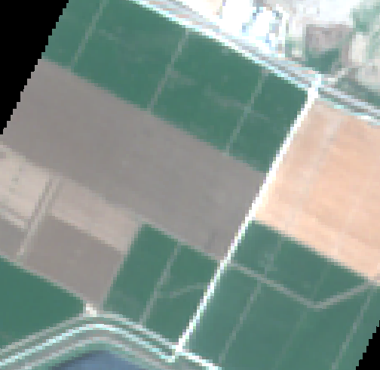
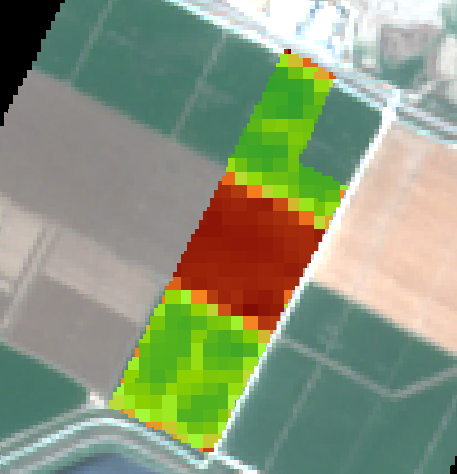
Plot Yifaat 6 2022

Slide 26
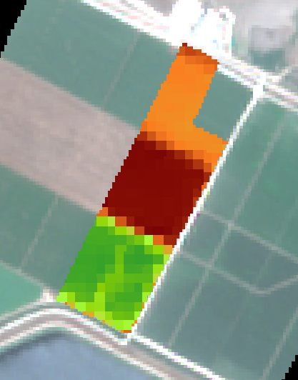
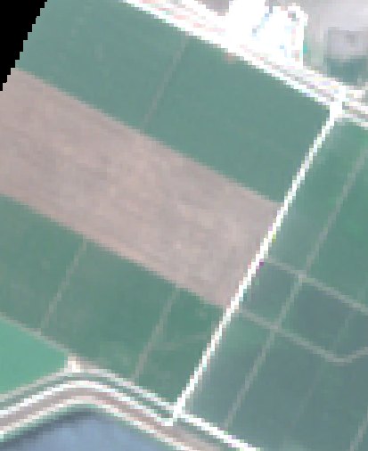
Plot Yifaat 6 2023

Slide 27
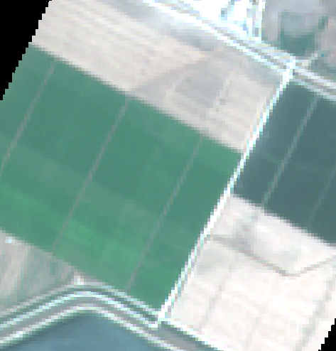
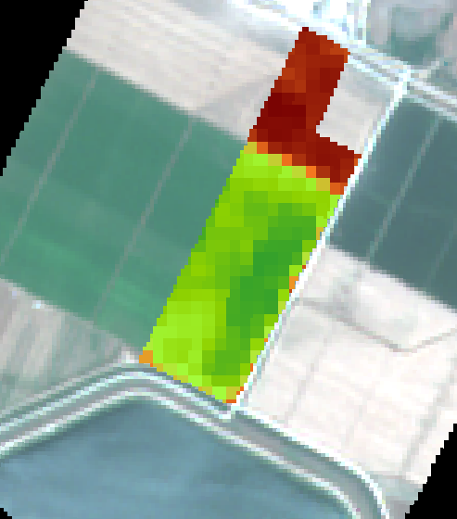
Plot Yifat 6 2023

Slide 28
Step 5: Creation of Infestation Polygons – Identification of Severe Broomrape Hotspots
Objective: To locate severe broomrape hotspots in the reference year (Aleket ≥ 2) and extract their NDVI values for each year from 2011 to 2024, for tracking and comparison purposes

Slide 29
Actions Performed:
A filtering of points with Aleket levels 2 or 3 in the reference year was conducted for each of the 4 plots. Based on those points, NDVI values were extracted for each year from 2011 to 2024. The results were saved into files for future tracking and analysis.

Slide 30
Step 6: Logistic Regression Model (GLM)
Objective:
To examine whether it is possible to predict the likelihood of severe broomrape infestation in a field based on NDVI values.
Model Structure:
Dependent Variable (Y): Infestation_binary – a binary variable: 1 = severe infestation (Aleket ≥ 2), 0 = no severe infestation (Aleket < 2)
Explanatory Variable (X): NDVI_normalized – the normalized NDVI value.

Slide 31
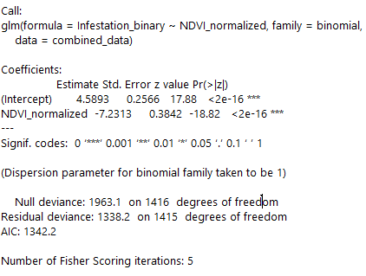

Slide 32
Additional Logistic Regression Model GLMM
Objective:
To build a predictive model that accounts for both the effect of NDVI on the likelihood of severe broomrape infestation and the variability between different plots.
Structure of our model:
Dependent Variable (Y): Infestation_binary – a binary variable: 1 = severe infestation, 0 = not severe
Fixed Explanatory Variable: NDVI_normalized – the normalized NDVI value
Random Variable: Field – the plot from which the pixel originated ⇒ This allows the model to account for the fact that each plot has different dynamics (crop type, soil, environmental conditions)

Slide 33
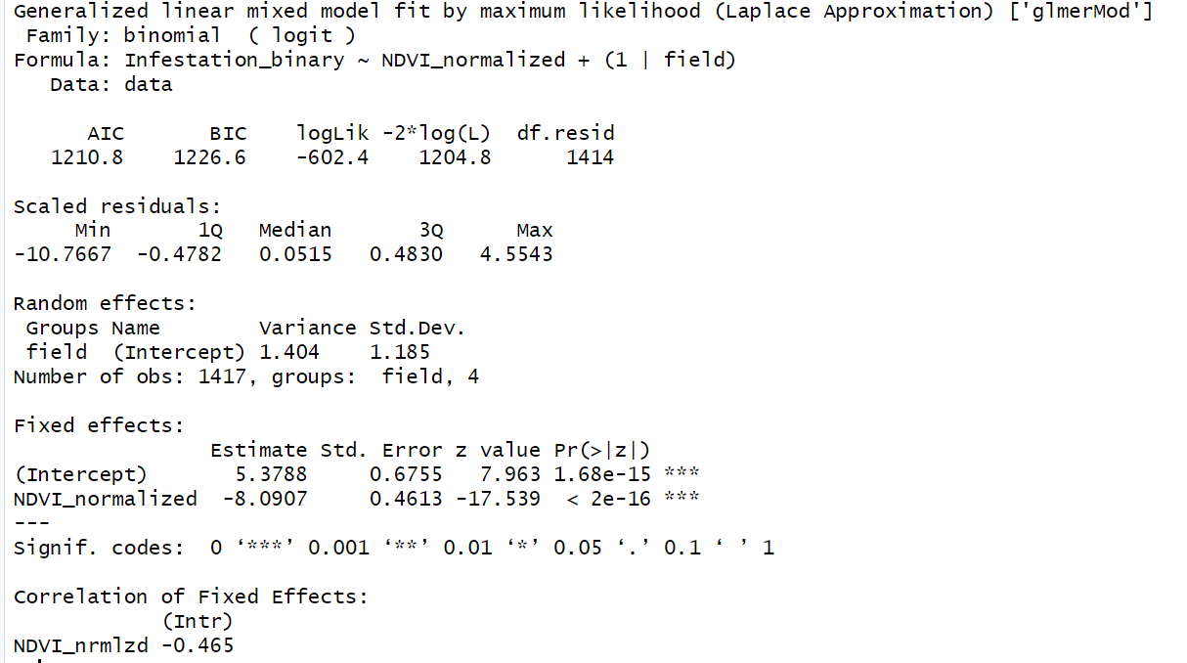

Slide 34
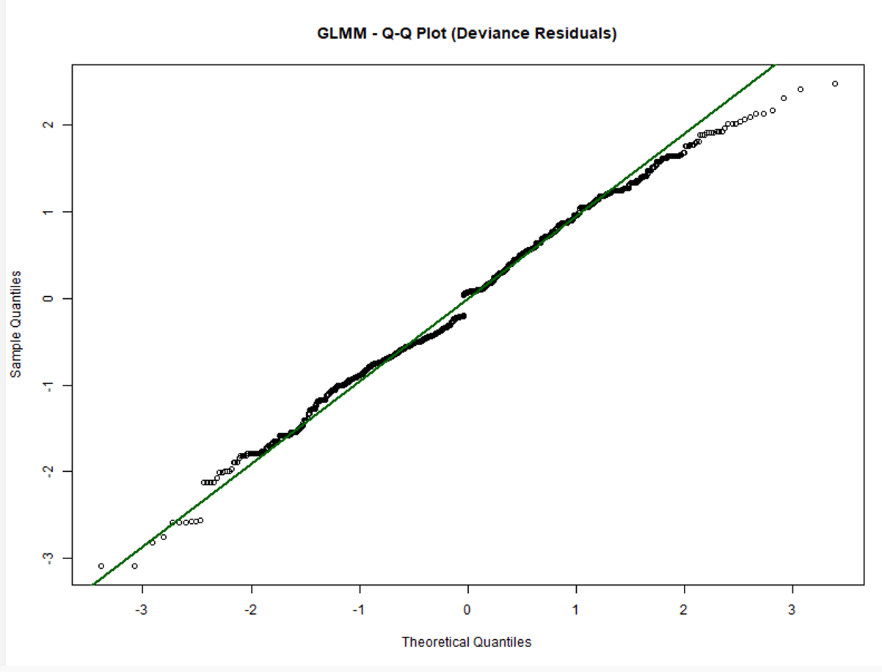
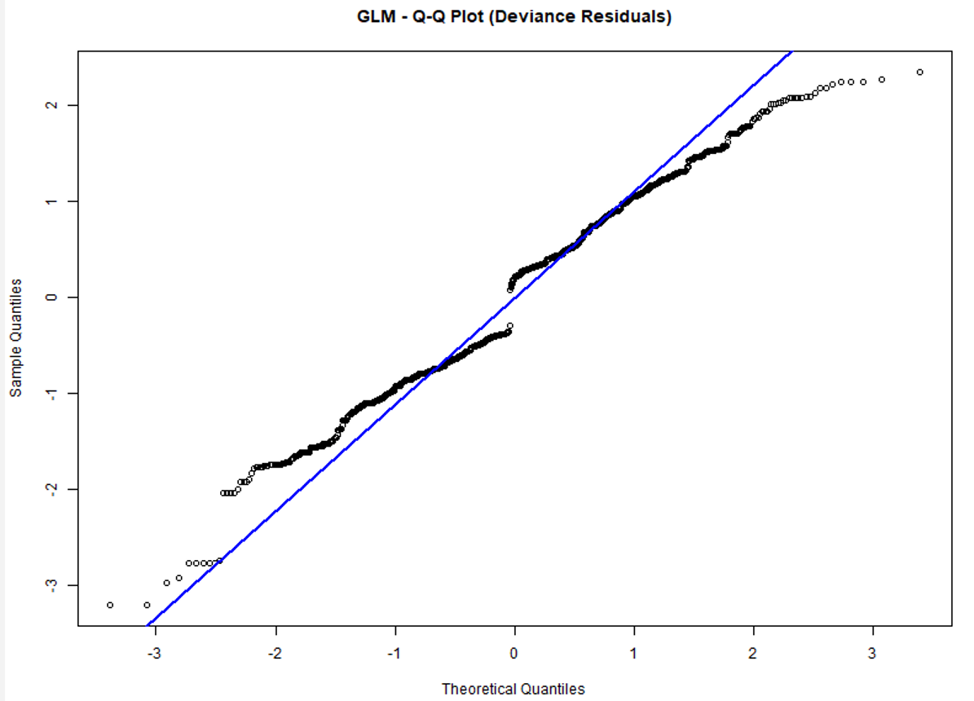


Comparison of the models: GLMM was chosen as our model

Slide 35
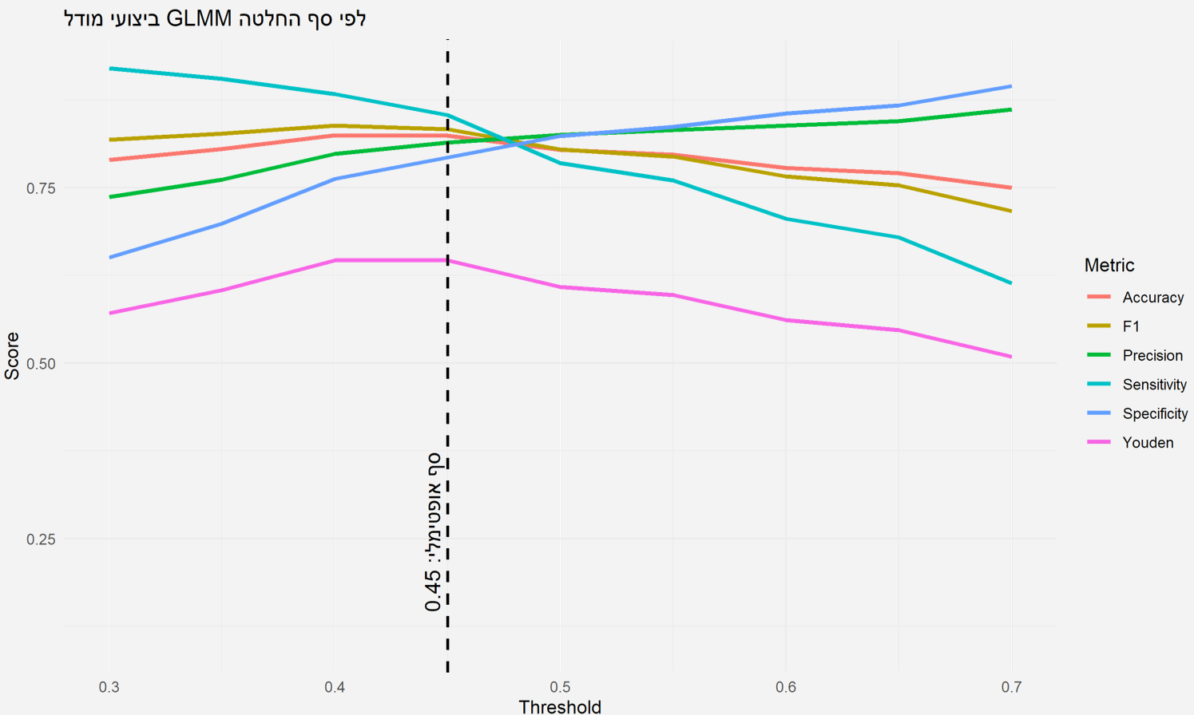
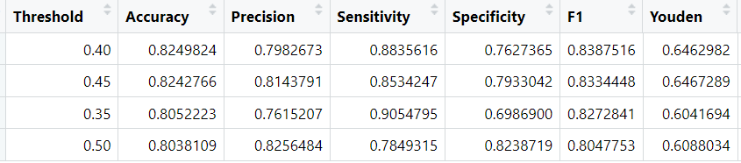
Choosing a Probabilistic Rule
A threshold of 0.45 provides the best balance between correctly identifying leeches and avoiding false alarms – which is why the optimal decision money is chosen.
Notes:
Accuracy – General Accuracy
Precision – Percentage of Predictors as Infected Who Are Actually Infected
Sensitivity – the percentage of infected people who were found to be correct
Specificity – the percentage of healthy people who have been correctly classified
F1 Score - A measure that balances success in identifying infected people and avoiding false alarms.
-Youden IndexA general measure of classification quality, which checks how well the model identifies both infected and uninfected people.

Slide 36
Work Plan for the Coming Week
Run the model on patches over the years
Run the model on the fields Roni uploaded to the Drive this week
Prepare a presentation for Seminar 4
Prepare a poster
Points for Discussion with Professor Yael:
Key points for the presentation (which will also be used at the conference)
How many slides for background on the topic (what is broomrape, etc.)
How many slides on tools and methods
How many slides for results
How many slides in total? What should be emphasized? Also in terms of the presentation style
Key points for the poster – what should it include?
Key points for writing the final report (due by the end of the month)
Can we schedule ~20 minutes on 11/06 to present the Seminar 4 presentation?

Slide 37
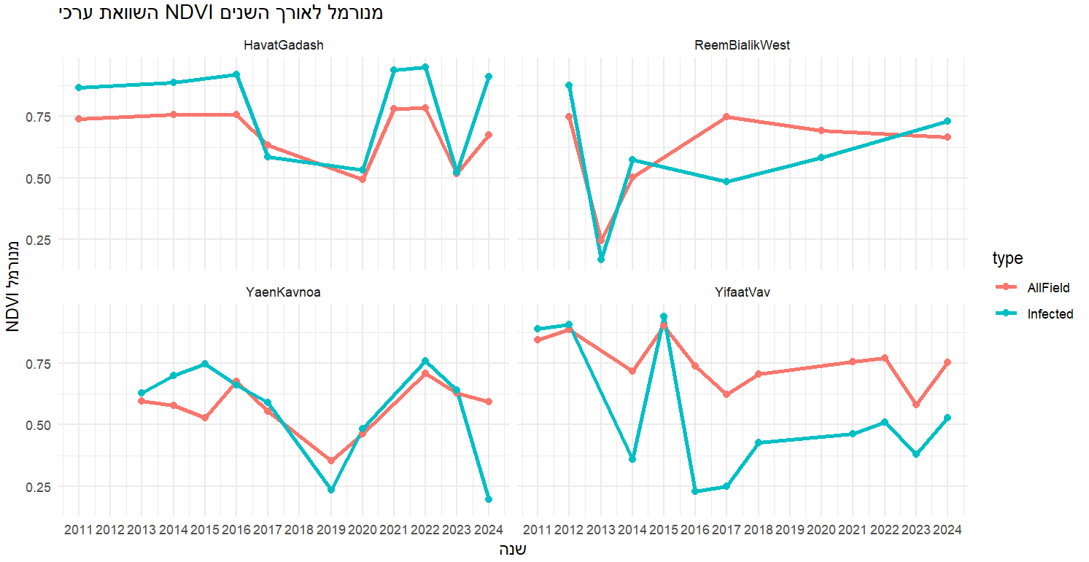
Comparison of Normalized NDVI Values Over the Years
Normalized NDVI
Year

